Slide 1
Look at the following adverts/articles and consider what laws they may be breaking and why

Slide 2
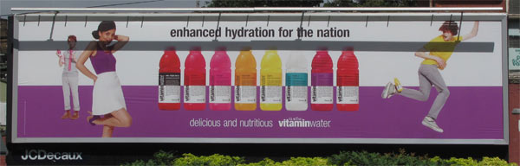
The Sales of Goods Act 1979
Coca Cola advertised this drink as nutritious implying it was healthy, when it actually contained 30g of sugar per 500ml.

Slide 3
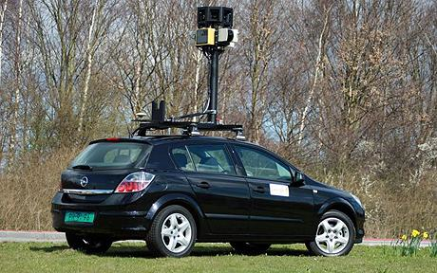

The Data Protection Act 1998
The company is accused of unlawfully harvesting data including emails, passwords and website addresses during the creation of the popular street view product.

Slide 4

The Sale of Goods Act 1979
http://www.guardian.co.uk/media/video/2008/nov/26/apple-iphone?INTCMP=ILCNETTXT3486

Slide 5
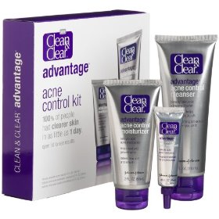
The Sales of Goods Act
http://www.guardian.co.uk/media/video/2010/jan/06/clean-and-clear-advert
This advert uses makeup when advertising the effectiveness of its product.

Slide 6
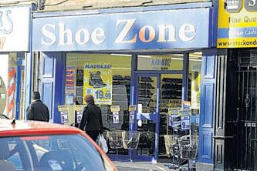
Consumer Protection Regulations
In January this year, Shoe Zone, in Lincoln's High Street, advertised it was having a "closing down" sale before having a refit.
An employee of Shoe Zone told the Echo the store had been closed for five days while the floor was repaired.
Trading standards confirmed it is investigating the branch of Shoe Zone, because it may have given customers the misleading impression that prices had been changed because the store was closing down.

Slide 7
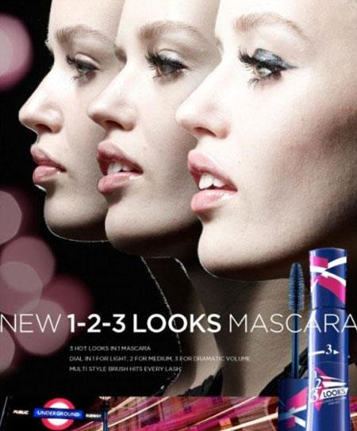
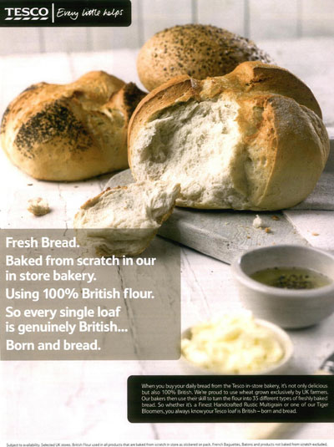
What examples did you find ?
How do these legislations limit marketing ?

